Slide 1

Introductory Circuit Analysis
Feng Xiaoyi
School of Electronics and Information in NPU
2020.3

Slide 2
About me
Feng Xiaoyi
Professor
School of Electronics and Information
Major: Circuit and System
Email: fengxiao@nwpu.edu.cn

Slide 3
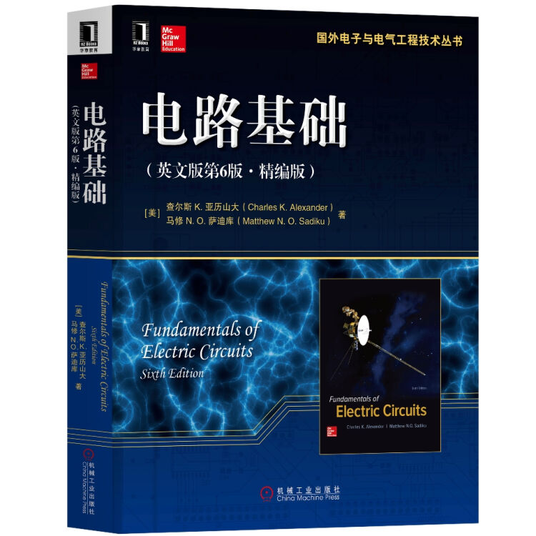
Fundamentals of Electric Circuits
(Sixth Edition)
Charles K.Alexander
Matthew N.O.Sadiku
Textbook

Slide 4
6. Recommended Reading
Hayt. Kemmerly,&Durbin, Engineering Circuit Analysis, McGraw-Hill, 8th, Edition
Alexander & Sadiku, Fundamentals of Electric Circuits, McGraw-Hill,2007
Nilsson & Ricedel, Electric Circuits, Pearson, 7th, 2005
Irawin, Basic Engineering Circuit Analysis, John Wiley & Sons, 7th,2002
G.Polya, How to Solve It, Princeton Press, the world-famous best-selling book teaches the reader how to develop winning strategies in the face seemingly impossible problem.

Slide 5
Some Requirements
Attend the Lectures on Time
Student who miss the class for three times for no reason is not eligible for final exam
Finish Assignment in Time
Student who does not submit homework three times is not eligible for final exam

Slide 6
Examination
Attendance/Assignment 10%
Quiz and homework 20%
Final examination 70%

Slide 7

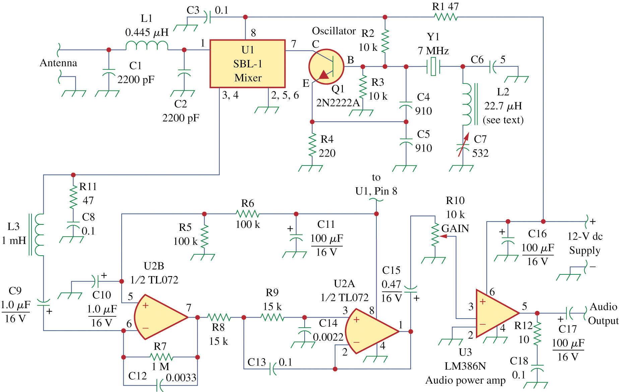
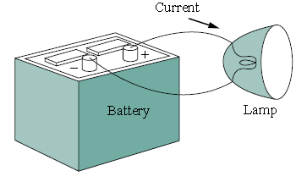
chapter 0 Overview of the Course
What is a circuit?
Figure 1.1 A simple electric circuit
Figure 1.2 a complicated real circuit
（Electric circuit of a radio receiver）
An electrical circuit is formed using a number of components, such as batteries, wires, capacitors, resistors and switches.
Functions:
(a) The transfer, distribute and transform of energy;
(b) The transfer, control and process of signals.

Slide 8
2. What is circuit analysis?
Our major concern in this course is the how to study the behavior of the circuit: How does it respond to a given input? How do the interconnected elements and devices in the circuit interact?
We will deﬁne some basic concepts: charge, current, voltage, circuit elements, power, and energy.
Circuit analysis is the process of determining voltages across (or the currents through) the elements of the circuit.

Slide 9
3. Circuit analysis can be separated into two broad categories
  Linear circuit analysis
  linear circuit: the equations(voltage-current relationship) characterized the circuits are linear algebraic or linear differential equations.
  Nonlinear circuit analysis
This course deals with linear circuit analysis.

Slide 10
4. Linear circuit analysis can be separated into four broad categories
  DC analysis: A direct current (dc) is a current that remains constant with time.
  Transient analysis: things often change quickly
  AC analysis: An alternating current (ac) is a current that varies sinusoidally with time.
  Frequency response analysis: the most general of the four categories, but typically assumes something is changing with frequency

Slide 11
5. The simple fact of the matter is that no physical system is ever perfectly linear. Then why study linear analysis?
  A great many systems behave in a reasonably linear fashion over a limited range----allowing us to model them as linear systems if we keep the range limitations in mind.
  Linear problems are inherently more easily solved than their nonlinear counterparts.

